Slide 1

Manufacturing defect detection in ball bearings
Group-5
Dedeepya vesangi
Harshitha Manaswini Vadavalli
Nithin Aleti
Notes:
Hi. Welcome to our data mionin

Slide 2
Agenda
Problem Description
Objective
Data Visualization
Algorithm Used and results
Learnings

Slide 3
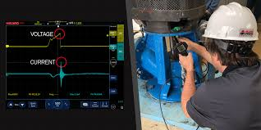
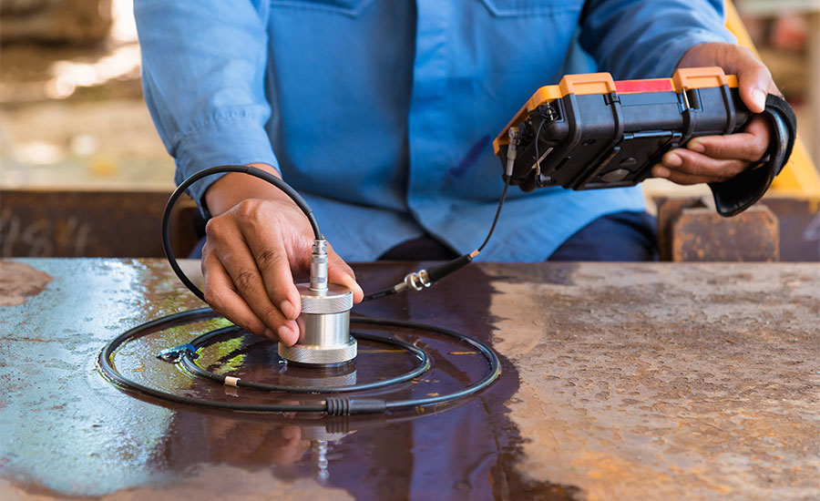
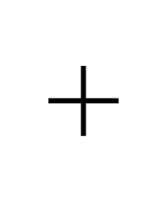

Problem description
The task is to use industrial dataset containing observations from destructive and non-destructive tests on ball bearings to build a classification model that accurately detects manufacturing defects.
Number of Samples: Approximately 230,000
Number of Attributes: 30

Slide 4
Objective
The objective of the project is to develop classification model that can effectively identify manufacturing defects in ball bearings based on observations from destructive and non-destructive tests. By accurately classifying ball bearings as defective or non-defective, the model aims to improve quality control in the manufacturing process, reduce production costs associated with defective products, and ensure the delivery of high-quality goods to customers.

Slide 5
Steps
Data Loading
Data preprocessing
Selecting Algorithm and Training
Algorithm Performance
Data Visualization
Notes:
data loading: The first step of our project was to load the dataset for analysis. The dataset contains information collected from destructive and non-destructive tests on ball bearings.
Data visualization is a critical step to help us understand the dataset and uncover patterns or relationships between features."

Slide 6
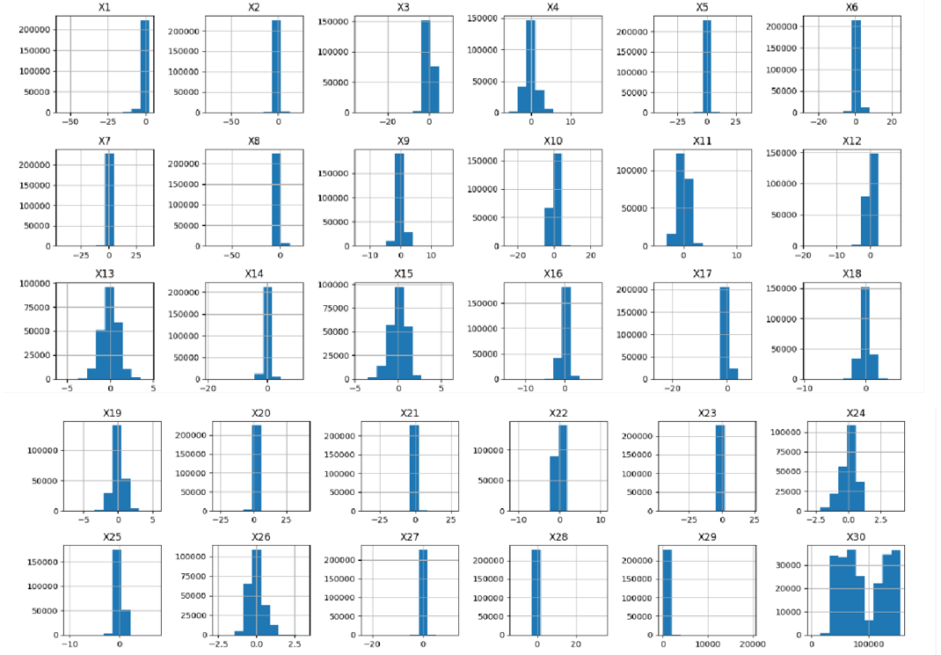
Data Visualization

Slide 7

Data Preprocessing
Data preprocessing serves as a critical preparatory step in the Data analysis pipeline, laying the foundation for effective model training, evaluation, and deployment. By ensuring that the data is clean, consistent, and well-structured, preprocessing maximizes the chances of building accurate and reliable models that can deliver meaningful insights and solutions.
Observations
The given data has no null values.
The value of each predictor ranges greatly. The minimum value is -72.715728 and maximum value is 154674.000000. Classification models are sensitive to the scale of values used. This creates biased model and predictor with large scale will influence the outcome more.
Notes:
1.⁠ ⁠Clean Data:
"The dataset had no missing values, which saved us time on cleaning."
2.⁠ ⁠Range of Values:
"Predictors had values ranging from -72.7 to 154,674, which could cause problems because machine learning models are sensitive to large differences in scale."
"For example, features with bigger numbers could dominate the results, leading to bias."
3.⁠ ⁠Class Imbalance:
"Out of 230,000 samples, 229,541 were non-defective, while only 458 were defective. This imbalance means the model could easily favor predicting non-defective cases, ignoring defects."

Slide 8
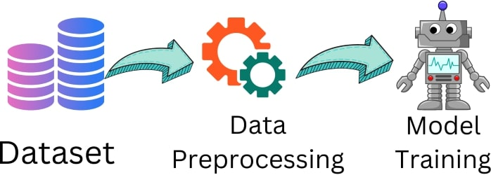
Data preprocessing
Standardization of Data
In the context of manufacturing defect detection in ball bearings, applying Standard Scaler to the dataset can help ensure that the observations from different tests (predictors) are on a similar scale, enabling the model to learn effectively from the data without being influenced by the inherent scaling differences between predictors. This can ultimately lead to more accurate and reliable predictions of defects in ball bearings.
Null Value removal
Null value removal, also known as deletion or dropping, involves removing observations (rows) or variables (columns) that contain null values from the dataset
Notes:
1.⁠ ⁠Clean Data:
"The dataset had no missing values, which saved us time on cleaning."
2.⁠ ⁠Range of Values:
"Predictors had values ranging from -72.7 to 154,674, which could cause problems because machine learning models are sensitive to large differences in scale."
"For example, features with bigger numbers could dominate the results, leading to bias."
3.⁠ ⁠Class Imbalance:
"Out of 230,000 samples, 229,541 were non-defective, while only 458 were defective. This imbalance means the model could easily favor predicting non-defective cases, ignoring defects."

Slide 9
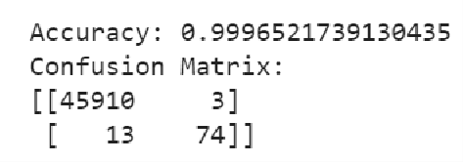
Model selection
Since we have large data, significantly less attributes compared to data points and we need the classification between only two classes (i.e., 0 or 1 ), we can consider Logistic Regression and Decision Tree models.
Logistic Regression
Performance Metrics:
We achieved a very high accuracy of 99%
Specificity = 0.99993
Simplicity = 0.85057

Slide 10
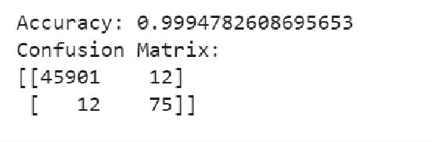
Model selection
Decision Tree
The results for both Decision tree and Logistic Regression is almost same. But comparatively Logistic Regression was better.
Specificity = 0.99971
Simplicity = 0.85057

Slide 11
Observed data problem
In the given Training data, we have observed a problem that will cause a serious prediction error.
Total number of Non defective ball bearings is 229541, Total number of defective ball bearings = 458.
This is a very huge difference of data points between two classes. The model may predict the non-defective ball bearings correctly, but it fails to read the patterns of Defective ball bearings

Slide 12
Data resampling
Oversampling is a technique used in imbalanced classification problems where one class (usually the minority class) is underrepresented compared to the other classes. The goal of oversampling is to balance the class distribution in the dataset by increasing the number of instances in the minority class.
Under sampling is another technique used to address imbalanced classification problems, where the majority class is overrepresented compared to the minority class. Unlike oversampling, which increases the number of instances in the minority class, undersampling reduces the number of instances in the majority class to balance the class distribution.

Slide 13
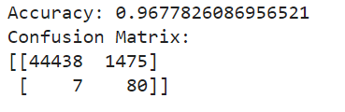
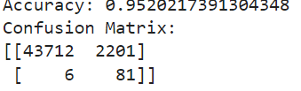
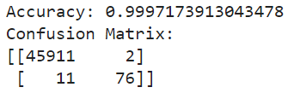
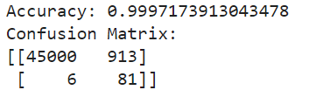
Results
Decision tree over sample technique
Decision tree under sample technique
Random forest over sample technique
Random forest under sample technique

Slide 14
Results
After carefully observing the accuracy, confusion matrix we can state that random forest over sample method is efficient compared to the decision tree.
As we know that there is imbalance in the dataset, we just resolved that by using the random resampling techniques. However, it has its own disadvantages.
These resampling techniques involves randomly duplicating or randomly removing data points. However, it may lead to overfitting or loss of important patterns. This sampling method introduces bias and hence it decreases the model performance.
Going forward, we will resolve this by using hybrid resampling method.

Slide 15
Hybrid Resampling Method:
A hybrid resampling method combines multiple resampling techniques, such as oversampling and undersampling, to address class imbalance in a dataset. The goal of hybrid resampling is to leverage the strengths of different techniques while mitigating their individual drawbacks.
Different methods can be used to implement this hybrid approach, including:
- Synthetic Minority Over-sampling Technique (SMOTE), which generates synthetic samples
for the minority class.
- Random undersampling, which randomly removes samples from the majority class.
- NearMiss, are the other advanced techniques for balancing data while maintaining important
features and relationships within the dataset.
Combining these techniques can be effective in creating a more balanced dataset for training
machine learning models, which in turn can improve classification accuracy and reduce bias.

Slide 16
Decision Tree:
Accuracy: 0.9936086956521739 Sensitivity: 0.8695652173913043
Specificity: 0.9997370612209124
Confusion Matrix:
[[45626 282]
[ 12 80]]
Random Forest:
Accuracy: 0.9992826086956522 Sensitivity: 0.8369565217391305
Specificity: 0.9996732382093454
Confusion Matrix:
[[45890 18]
[ 15 77]]

Slide 17
Model Selection
Support Vector Machines (SVM) are a class of supervised learning algorithms used for classification, regression, and outlier detection. They are particularly known for their robustness in handling high dimensional data and achieving high accuracy, especially in binary classification tasks.
Accuracy: 0.9855434782608695 Sensitivity: 0.9130434782608695
Specificity: 0.9998232395766588
Confusion Matrix:
[[45251 657]
[ 8 84]]
The results are not that good compared to other models.

Slide 18
What have we learned!
Addressing Class Imbalance
We tackled class imbalance by using techniques like oversampling, undersampling, and hybrid methods such as SMOTE, which improved data balance and classification accuracy for minority classes.
Model Evaluation and Comparison
Evaluating models with metrics like accuracy, sensitivity, and specificity helped us identify Random Forest with oversampling as the best performer, while noting challenges like overfitting and bias from resampling.
Future Improvements
We emphasized combining resampling techniques and exploring ensemble models to handle class imbalance effectively, alongside iterative enhancements in preprocessing, model selection, and evaluation.

Slide 19


